Slide 1

Java + Mobile course by Enered

Slide 2
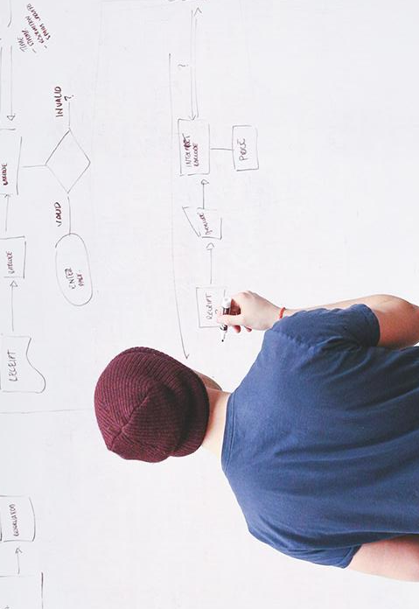
HELLO!
I am Vlad Butnaru
I will be your trainer for this Java session!
PS: It’ll be awesome!

Slide 3
Module 2: OOP

Slide 4
What will we do today
The structure of a class
Member variables
Methods
Constructors
Getters and setters
Objects (instances)
Exercises

Slide 5
Please pay attention
This module is very important!

Slide 6
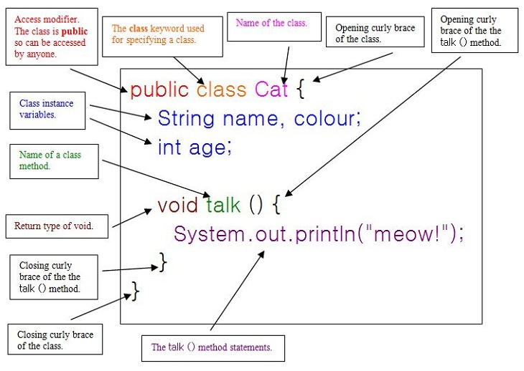
The structure of a class

Slide 7
2. Member variables
Variables that depend on the class instance
They can be Instances, Primitives, etc.
Their values reset every time you create a new instance (using “new” keyword)

Slide 8
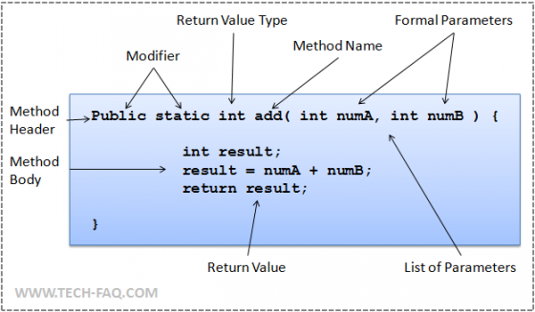
3. Methods

Slide 9
4. Constructors
Are methods called when you instantiate a class (you create an object with the “new” keyword);
They MUST be public and MUST have the same name as the class;
They can accept any number of parameters;

Slide 10
5. Getters and setters
Are methods that give access to member variables for external use
ALL member variables MUST be private, so getters and setters are the only way to access them
They MUST be public.

Slide 11
5. Objects
Are instances of a class;
The structure is: Class c = new Class();
The instances give access to all public entities in a class (methods, variables, etc);

Slide 12
6. Examples

Slide 13
THANKS!
Any questions?
You can find me at:
@web: http://vladbutnaru.com/
@facebook· Vladut Butnaru
@linkedin· Vlad Butnaru
@email : vlad2me@gmail.com
@phone : +40 0754 827 620

Slide 14
Feedback please!
http://bit.do/feedbackvlad

